Slide 1

Lecture
on
“CBNST LAB –PMA-402”
by
Akansha Gupta
DEPARTMENT OF COMPUTER SCIENCE AND ENGINEERING
GRAPHIC ERA DEEMED TO BE UNIVERSITY

Slide 2
NEWTON FORWARD INTERPOLATION METHOD

Slide 3
Interpolation
Interpolation is the technique of estimating the value of a function for any intermediate value of the independent variable, while the process of computing the value of the function outside the given range is called extrapolation.

Slide 4
Forward Differences
The differences y1 – y0, y2 – y1, y3 – y2, ……, yn – yn–1 when denoted by dy0, dy1, dy2, ……, dyn–1 are respectively, called the first forward differences. Thus the first forward differences are :

Slide 5
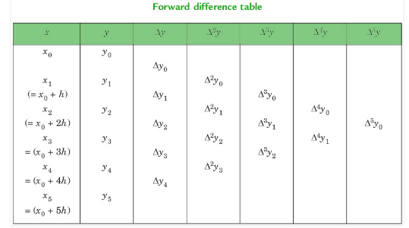
Forward Difference Table

Slide 6
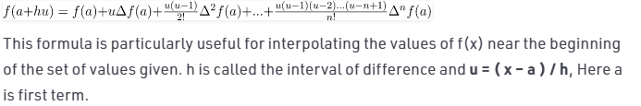
Newton Forward Interpolation Formula

Slide 7
Pseudo code of Newton’s Forward Interpolation
NEWTONFORWARD()
{
Read n // number of observation
For j = 0 to n-1 (step 1)
For i = 0 to 1
Read a[j][i] // read the given values say x and y
End For
End For
//Creating forward difference table
For j = 2 to n (step 1)
For i = 0 to n-j (step 1)
a[i][j]=a[i+1][j-1]-a[i][j-1]
End For
End For

Slide 8
Contd….
//Now display the difference table
For i = 0 to n-1 (step 1)
print next line
For j=0 to n-i (step 1)
print a[i][j]
End For
End For
Read x // value for which we want to find the y
If ((x<x[0]) OR (x>x[n-1]))
Print "input value is out of bound"
Exit
EndIf

Slide 9
Contd….
//Evaluating u
u= (x-a[0][0])/(a[1][0]-a[0])[0]) // u or p
u1=u
Y = a[0][1]
For i = 2 to n (step 1)
y = y + (u1*(a[0][1]/k))
u1= u1 × (u - (i - 1))
k = k * i
End For
Print "Result is : " y
}

Slide 10
https://youtu.be/AI3Pfy8A4HI
THANKS

